Slide 1
K Way Information Corp. Investors Conference
報告人：Max Feng
2026-03-13

Slide 2
Disclaimer
The predictive information mentioned in this presentation, including market outlook, financial status, and business forecasts, does not carry an obligation to update such data due to new information, future events, or any subsequent circumstances. This presentation does not explicitly or implicitly express or guarantee the accuracy or reliability of the information provided, nor does it represent a complete discourse on future developments.

Slide 3
Company Overview
Operations & Development
Financial Performance
Future Outlook

Slide 4
Company Overview
Founded：1985-05-22
Listed：2000-10-12
Capital：NTD 386,746,000.
Employees：148人
Location：Taepei Headquarter；Taichung Office
Website： http://www.kway.com.tw/
Positioning：Fintech software and talent cultivation
Affiliates：K Way Investment(100%)；KASH Securities Investment Consulting (85%)

Slide 5

Operations & Development: Products and Services
Trading
High-Frequency Trading (HFT): Efficient systems for securities and futures across multiple environments
XTrade2, XFuture2, DT3, FT3, KS3, DMA-100, DT4Aphla
Order Management System (OMS): Facilitates order placement for brokers, legal entities, and international units.
XOMS、XPATS2
VIP System (NPC): Supports diverse conditional ordering for high-net-worth clients.
Gateway
An integrated data exchange gateway for client messaging. (XGateway)
Integrates with international platforms (Bloomberg、Fidessa、Reuters)
Modularized/Flexibility (QFII, Stock, Future, Option, FIX, …)
Settlement
Brokerage clearing and settlement (XBOS、XBOS2、XFBOS)
Interfaces with international mechanisms (Omgeo CTM)
Complies with domestic exchange regulatory reporting.

Slide 6
Operations & Development: Products and Services (Cont.)
Application & Global Solutions
Online Trading (Home Trading System)
Mobile (APP)
Global products
AMD(HFT)、Broadriage(FIX)、 Groovenauts(AI)、MCT (MultiCharts)、QRAFT(AXE AI)、Xenon(HFT)
Total solution & Services
Securities, Futures and Sub-brokerage for Taiwan market.
Database Migration (MySQL、MS-SQL、Oracle、PostgreSQL)
Quantitative Trading: Analysis across four dimensions (Trend, Momentum, Capital, Risk).
Legacy Modernization: Using AI to convert legacy language (e.g., Cobol) to modern language (e.g., C#)。

Slide 7
Operation & Development : Talent Cultivation
KK SCHOOL：Founded in April 2023
Mission:
To train talent for fintech development and system maintenance.
Collaboration:
Industry/Government: Ministry of Digital Affairs, Taipei Computer Association.
Academia: Joint programs with National Chung Cheng University, Chung Yuan Christian University, Chang Gung University, and more.
Cultivation Stats
Software Development (18), System Maintenance (13), Project Management (5), AI Finance (8).

Slide 8
Operation & Development: Customers Reference
Institutional
Domestic (21家)
Forgien (11家)
Retail
MC：more than 39,000 members
App：more than 1M download times

Slide 9
Financial Performance: Operation revenue
Notes:
差異分析:EPS下滑：1. 因合併孫公司(凱旭投顧)及辦理現增員工認股，使本期管理費用大幅增加。
2. 本期業外投資因股票評價較去年同期大幅損失，致使本期EPS減少。

Slide 10
Financial Performance: Profit
Notes:
2025Q3差異分析：本期毛利率回升，使營業利益率成長，但稅前純益率卻下滑，主要是本期業外投資因股票評價大幅損失所致。
2022年稅前純益率：毛利率低和業外收益較前一年度低。

Slide 11
Financial Performance—Income Statement
Consolidated Statement of Comprehensive Income
(Unit: NTD Thousands) | 2025 | 2024
Net sales revenue | 304,597 | 270,433
Operating cost | 160,021 | 172,039
Gross profit | 144,576 | 98,394
Operating expense | 130,086 | 102,691
Operating income | 14,490 | (4,297)
Non-operating income and expense | (13,438) | 77,433
Profit before income tax | 1,052 | 73,136
Net income | (2,654) | 69,147
Earnings per share (NT$) | (0.06) | 2.25
Notes:
差異分析:1.營業毛利增加：因去年同期有一筆AML專案毛利率較低，但占營收比例較高，導致去年營業毛利較以往低，而今年營業毛利則恢復正常表現。
2.營業費用增加：因本期合併孫公司(凱旭投顧)及辦理現增員工認股，使本期管理費用大幅增加。
3.營業外收支減少：主要因本期投資股票評價大幅損失所致。

Slide 12
Financial Performance: Balance Sheet
CONSOLIDATED BALANCE SHEET
(Unit: NTD Thousands) | 2025/12/31 | 2024/12/31
Current Assets | 559,687 | 536,884
Noncurrent Assets | 395,109 | 99,660
Total Assets | 954,796 | 636,544
Current Liabilities | 145,701 | 126,421
Noncurrent Liabilities | 118,771 | 56,912
Total Liabilities | 264,472 | 183,333
Equity Attributable to Shareholders | 690,324 | 453,211
Book value per share(NT$) | 17.76 | 14.62
Debt Asset Ratio | 27.7 | 28.8
Current Ratio | 384.13 | 424.68
Quick Ratio | 362.59 | 413.65
Notes:
差異分析：1.非流動資產及資產總額增加：因本年度購入新辦公室不動產所致。
2.負債總額及權益總額增加:因本期辦理現金增資，使股本增加；暨發行可轉換公司債，使負債增加所致。

Slide 13
Financial Performance: Cash Flows
CONSOLIDTATED STATEMENTS OF CASH FLOWS
(Unit: NTD Thousands) | 2025 | 2024
Net cash inflow from operating activities | 15,051 | 16,672
Net cash outflow from investing activities | (182,077) | 23,049
Net cash outflow from financing activities | 277,455 | (20,905)
Effect of exchange rate changes on cash and cash equivalents | 0 | 3
Net decrease in cash and cash equivalents | 110,429 | 18,819
Cash and cash equivalents, end of period | 229,005 | 118,576
Notes:
差異分析：1.投資流動淨現金流出增加：因本期購買辦公室不動產所致。
3.籌資活動淨現金流入增加：2025現金增資；2024發現金股利。

Slide 14
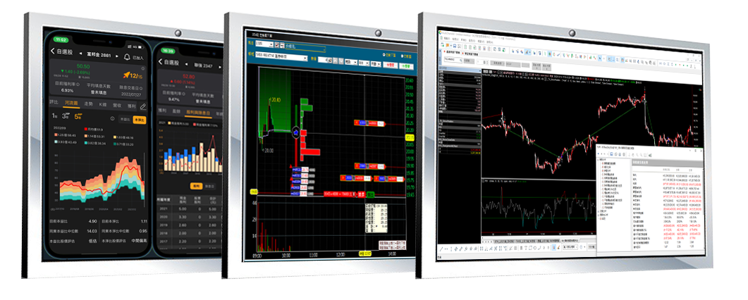
Future Outlook
Deepen relationships with key clients and stabilize niche product sales.
Strengthen core technical R&D through value innovation.
Leverage industry-government-academia resources for international talent cultivation.
Introduce Financial AI and provide Quantum Computing solutions.
Collaborate with international partners to build intelligent trading platforms.

Slide 15


THANK YOU

